Slide 1

RESTAURANT RECOMMENATION SYSTEM
FINAL IBM CAPSTONE PROJECT

Slide 2
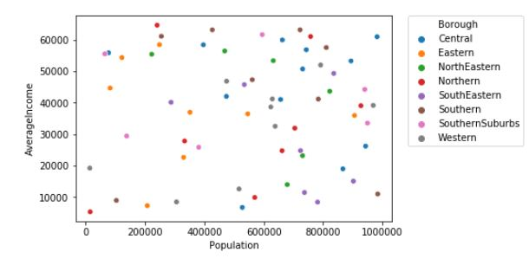
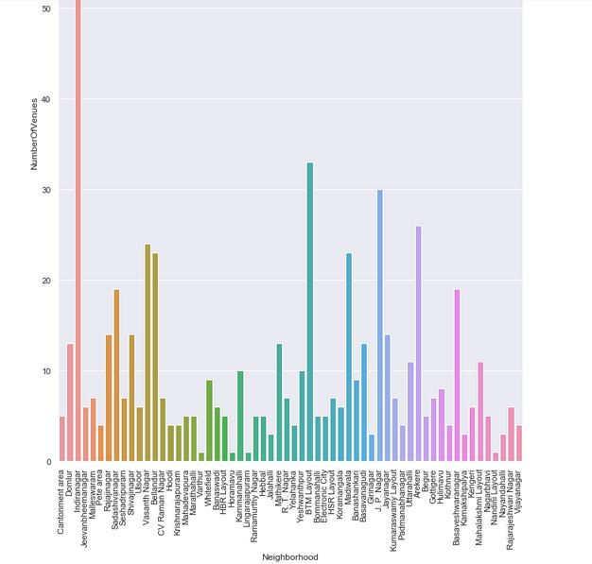
Recommender system : Machine Learning

Slide 3
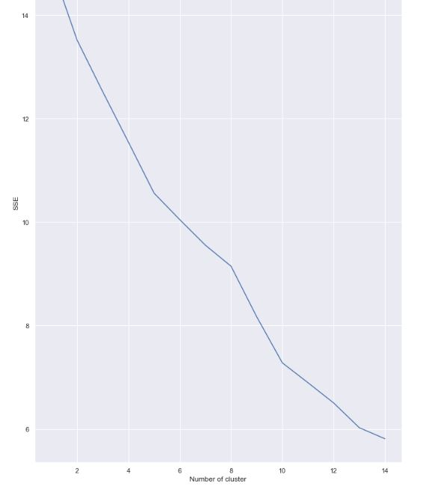
DATA VUSUALIZATION

Slide 4


Slide 5

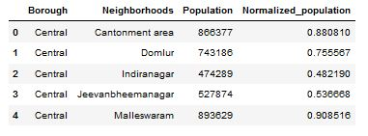
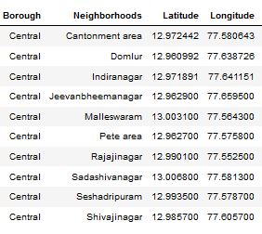
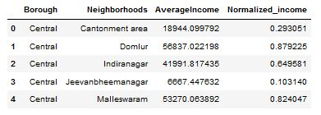
DATASETS

Slide 6

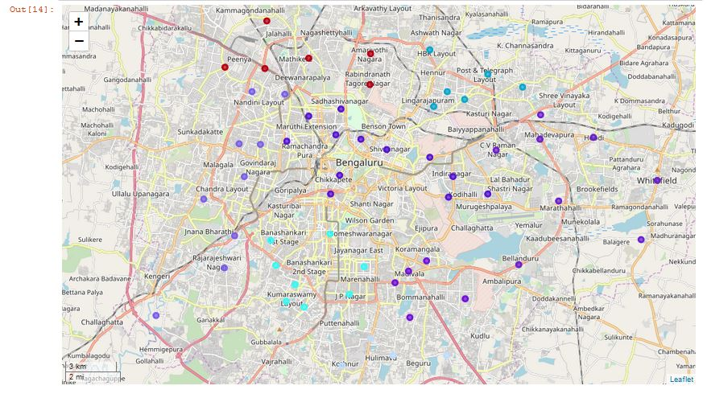
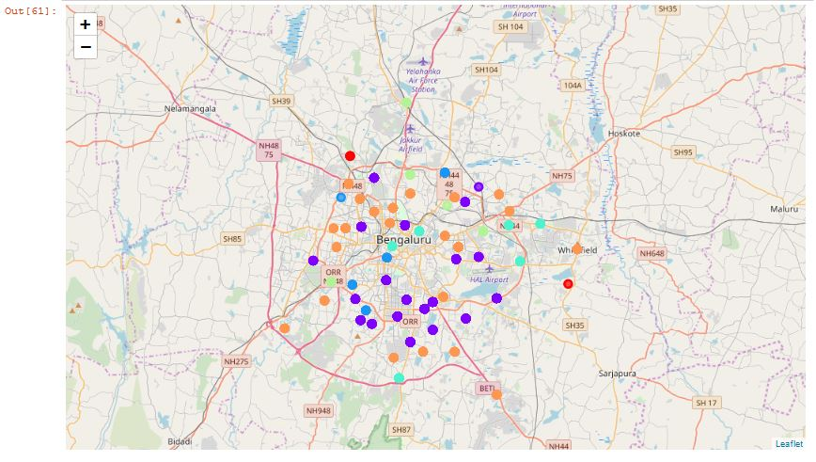
MAPS , CLUSTERING

Slide 7
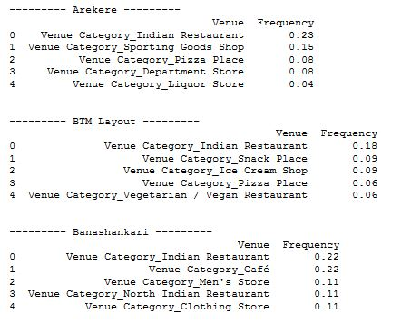

HENCE CONCLUDED THAT:

